Slide 1


Welcome To
District Officer Training
Leading Together

Slide 3
Agenda
10:00–10:20 — Opening Alignment. Facilitator: Steve Campion
10:20–10:30 — Recognition Moment. Celebrate What We Want to See More Of. Facilitator: Kevin O’Reilly
10:30–10:55 — Building and Inspiring Your Team. Facilitator: Elizabeth Jordan
11:00–11:15 — Break and Informal Learning
11:15–12:10 — Club Growth Lab: How to Start a Club Facilitators. Facilitators: Dan Deighton and Elizabeth Jordan
12:15–1:15 — Lunch
1:15-1:30 – Team Photos
1:30–2:00 — AI-Enabled Leadership: Using AI Responsibly in Your District Role. Facilitator: Georgina Hodgkinson
2:00–2:30 — Recognising the good, great and fantastic of a club and its members. Facilitator: Kevin O’Reilly
2:30–2:45 — Break and Informal Working
2:45–3:30 — District Leaders Roadmap and Area Success Planning Sprint Facilitated by the District Leadership Team
3:30–4:00 — Recognition Rocks! Commitments, Appreciation and Close. Facilitators: Trio

Slide 5
District Director
Steve Campion DTM
Mission, Member Promise and Communication Rhythm

Slide 7
Program Quality Director
Kevin O’Reilly
Celebrate What We Want to See More Of

Slide 9
Distinguished or better clubs
Lagan Valley Toastmasters | D
Engineers Club | D
Greystones Club | S
Talk Club @ Letterkenny | S
Belfast Toastmasters | M
Castleknock Toastmasters Club | P
Navan Club | P
Phoenix-Tara Toastmasters | M
Dublin 15 Toastmasters | M
Fil On Toast | D
Lucan Club | M
Clondalkin Talkin' | M
Rathfarnham Club | S
Tallaght Toastmasters | P
Tara Toastmasters | P
Dublin South TM | M
Sandyford TM | S
Tullamore Toastmasters Club | D
Athlone Club | S
Mullingar Toastmasters Club | M
Galway Club | M
Corrib Oranmore TMC | M
Naas Club | P
Portlaoise Club | D
Westport Speakers Club | D
Monaghan TM | S
Glasnevin Club | P
Ennis TMC | D
Dublin Club | D
Deloitte Toastmasters | D
IE Templebar TM | D
IFSC Toastmasters | P
Hellfire Club | M
East Coast Club | P
Swords Toastmasters | M
Malahide Club | P
Fingal Toastmasters | M
Balbriggan TM | D
Limerick Toastmasters | D
Thurles TMC | S
Clonmel Toastmasters | P
Waterford DLS TMC | D
Galway Club | M
Corrib Oranmore TMC | M
Westport Speakers C. | D
Drogheda TM Club | S
Toastmasters4Golf | S
Cloudera Ireland TM | D
Powdermills Club | S
Guardian Toastmasters | D
Bishopstown TM | M
Tullamore TMC | D
Athlone Club | S
Mullingar TMC | M
Speak Easy Club | P
Tralee Club | S
Killarney Club | P
The Limerick Lilts | D
Innovative Leaders TM | D
Talking Heads Club | S

Slide 11
Region 10 Advisor
Elizabeth Jordan DTM
Building and Inspiring Your Team

Slide 13


Ice-Breaker Question

Slide 15
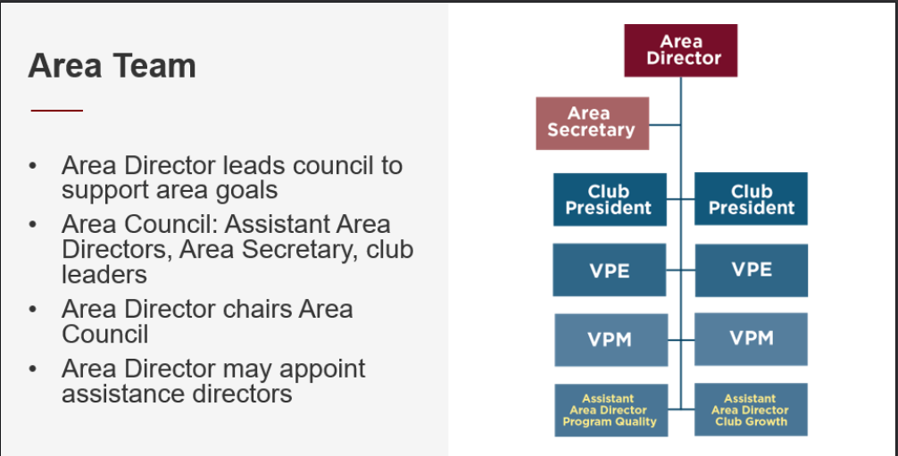

Slide 17
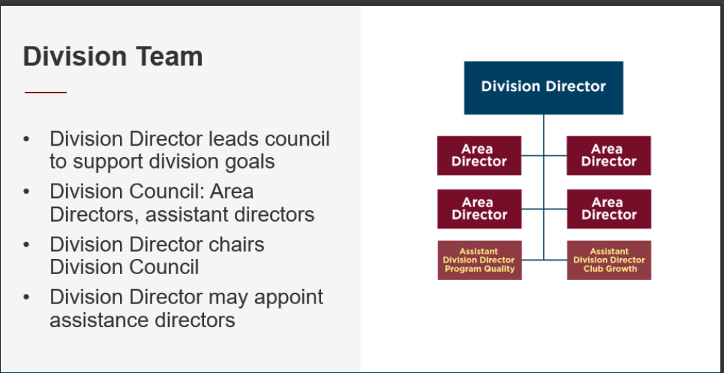

Slide 19

ACTIVITY #1: Build Strong Area & Division Teams
In your table group, discuss how you plan to build strong Area and Division teams
Write your ideas on a flip chart or A4 sheet
Appoint a volunteer to feedback top 2 ideas (1 minute)

Slide 21
Build Strong Area & Division Teams
Connect – Introduce yourself to team members (phone) / Rapport
Schedule your first council meeting. Establish a regular cadence.
Effective meetings (Parliamentary Procedure)
Establish communication channels (WhatsApp, email group, Teams)
Set a positive, supportive tone
Mission and Core Values
Communicate Clear goals – Club, Area, Division, District Success Plans
Role clarity
Training – COT, DOT, Focused Training e.g. team dynamics, building trust, goal-setting etc
Visit clubs

Slide 23
ACTIVITY 2: Inspire Area & Division Teams
In your table group, discuss how you plan to inspire your Area and Division teams
Write your ideas on a flip chart or A4 sheet
Appoint a volunteer to feedback top 2 ideas ( 1 minute)

Slide 25
Inspire Strong Area & Division Teams
Purpose not Pressure
Set a positive, supportive tone – Guest speakers, training
Team agreement
Recognise small and large achievements e.g. Area Director of the month
Listen and encourage
Clear purpose – Mission, core values
Accountability partner
Moment of Inspiration at start of meeting

Slide 27
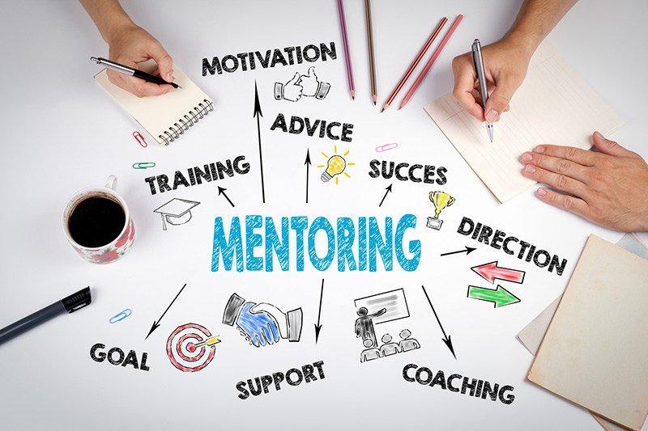
STRATEGIC INITIATIVE: EMPOWERMENT
OF AREA DIRECTORS (MENTORS)
Safe space
Support
Experience & Expertise
Consistency
Accountability
Motivation
Focus

Slide 29

Key Resources
Toastmasters International -Division and Area Directors – District Leader Tools
Toastmasters International -District Leadership Handbook
Peer group, past role holders, DLT

Slide 31

Action: One takeaway from today’s session
to help you build and inspire your teams.

Slide 33


Slide 35
Current Vacancies
2 x ADs in Division C16, C57
1 x AD in Division M07
3 x audit committee team members
1 x New Club mentor lead
1 x Club growth webinar lead

Slide 37
Club Growth Director
Dan Deighton
&
RA Elizabeth Jordan DTM
Club Growth Lab: How to Start a Club

Slide 39
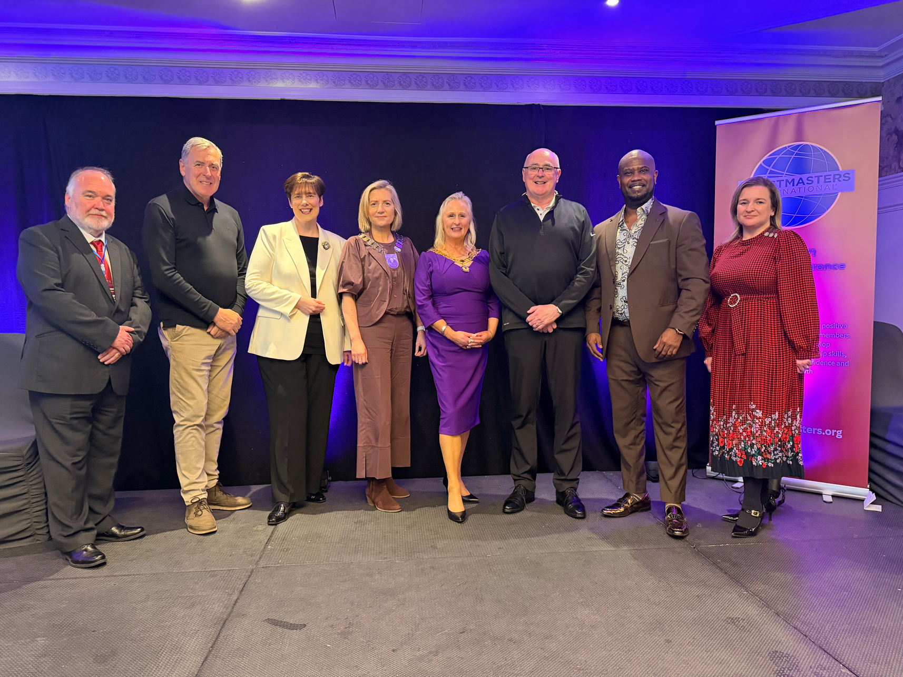
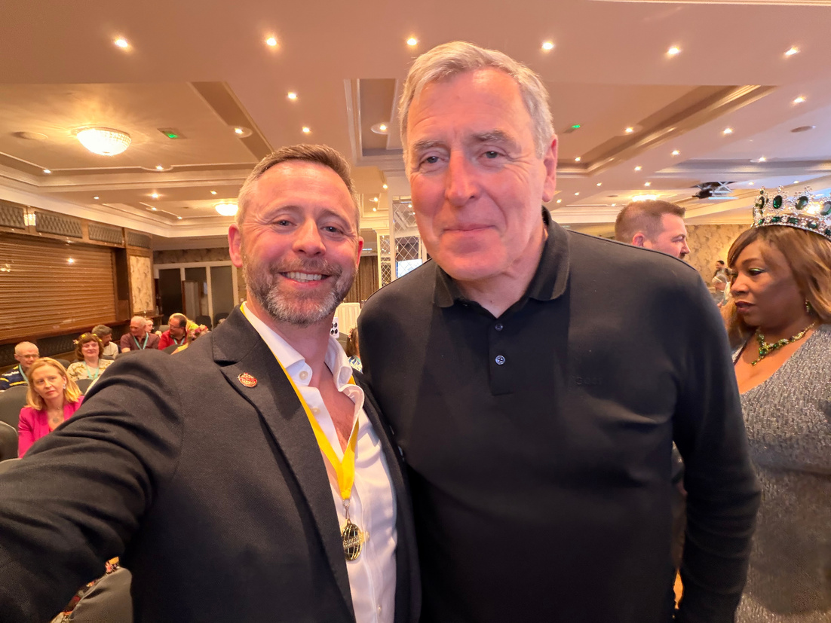
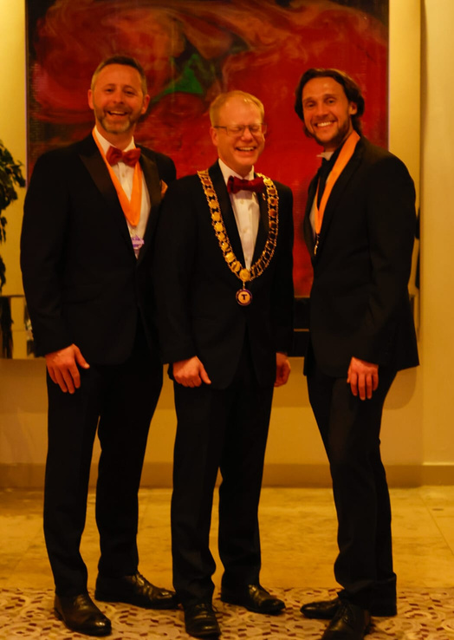
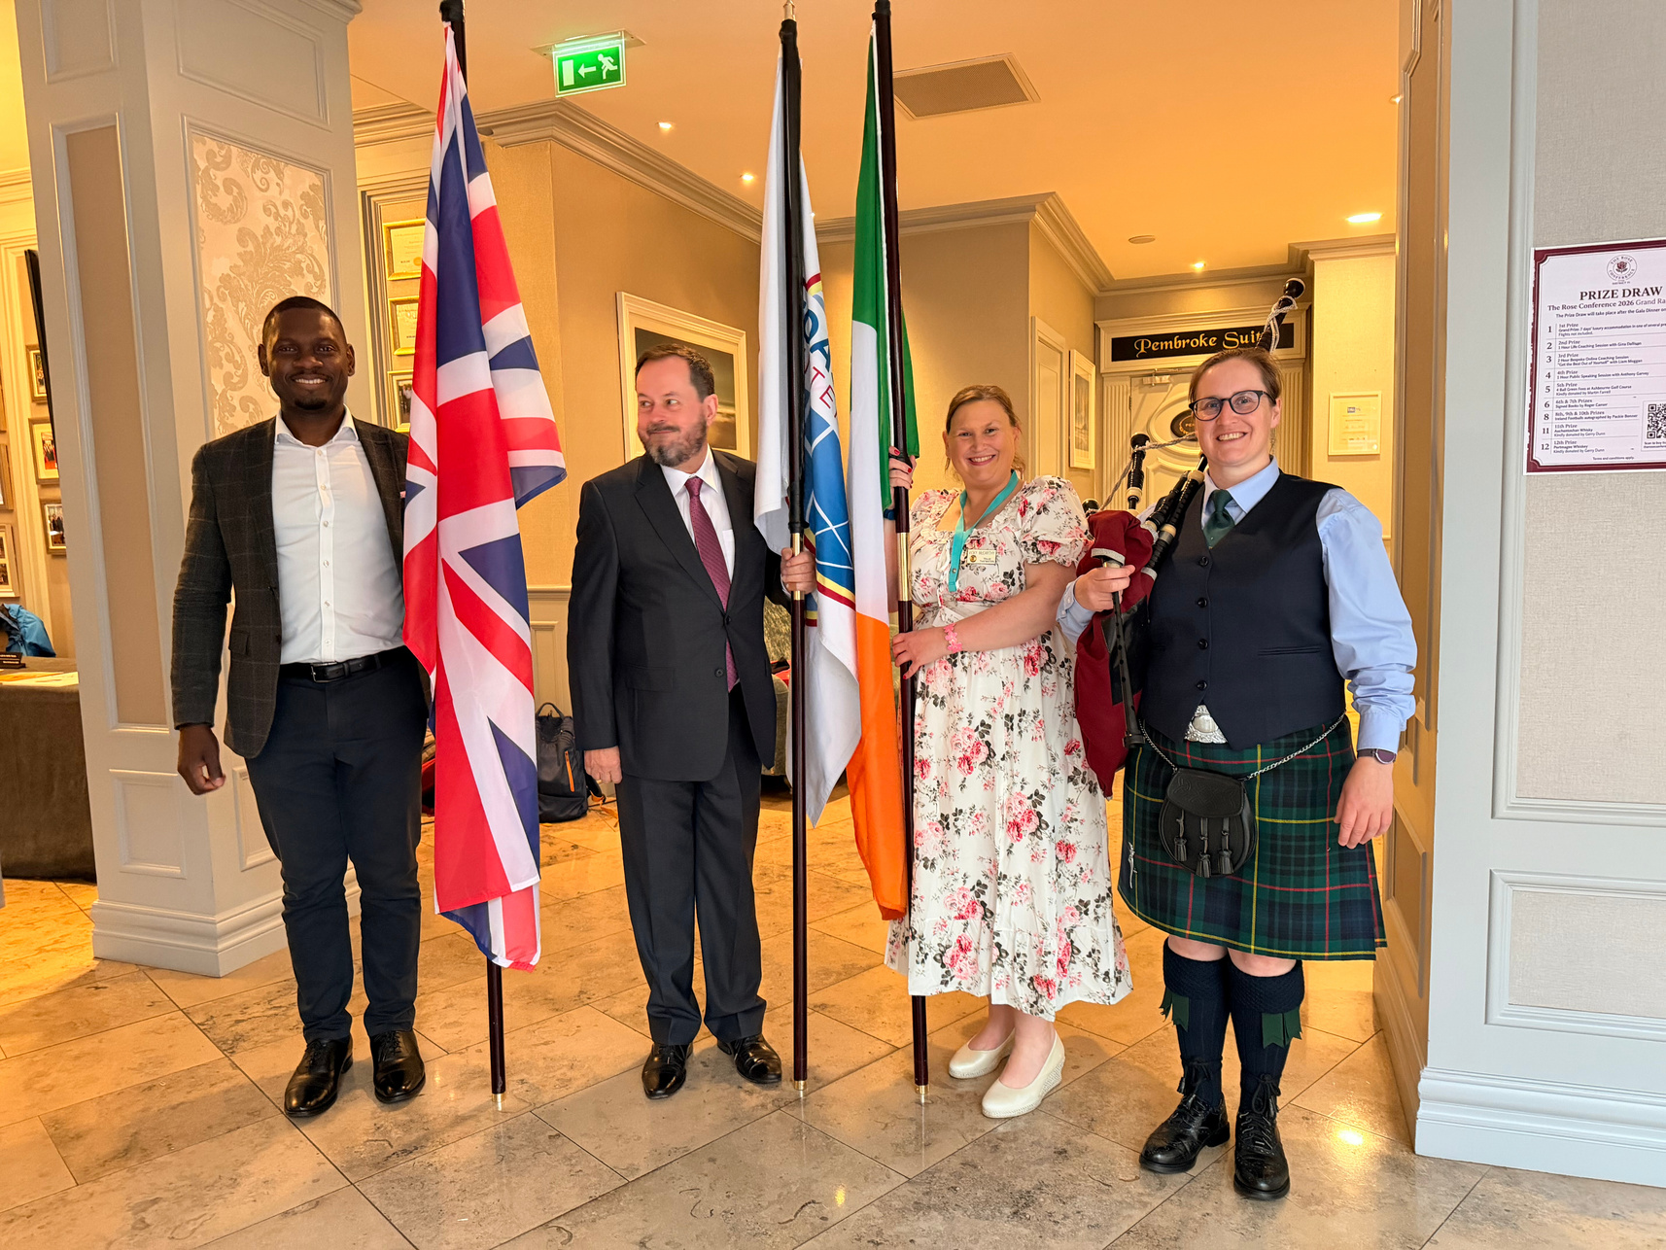
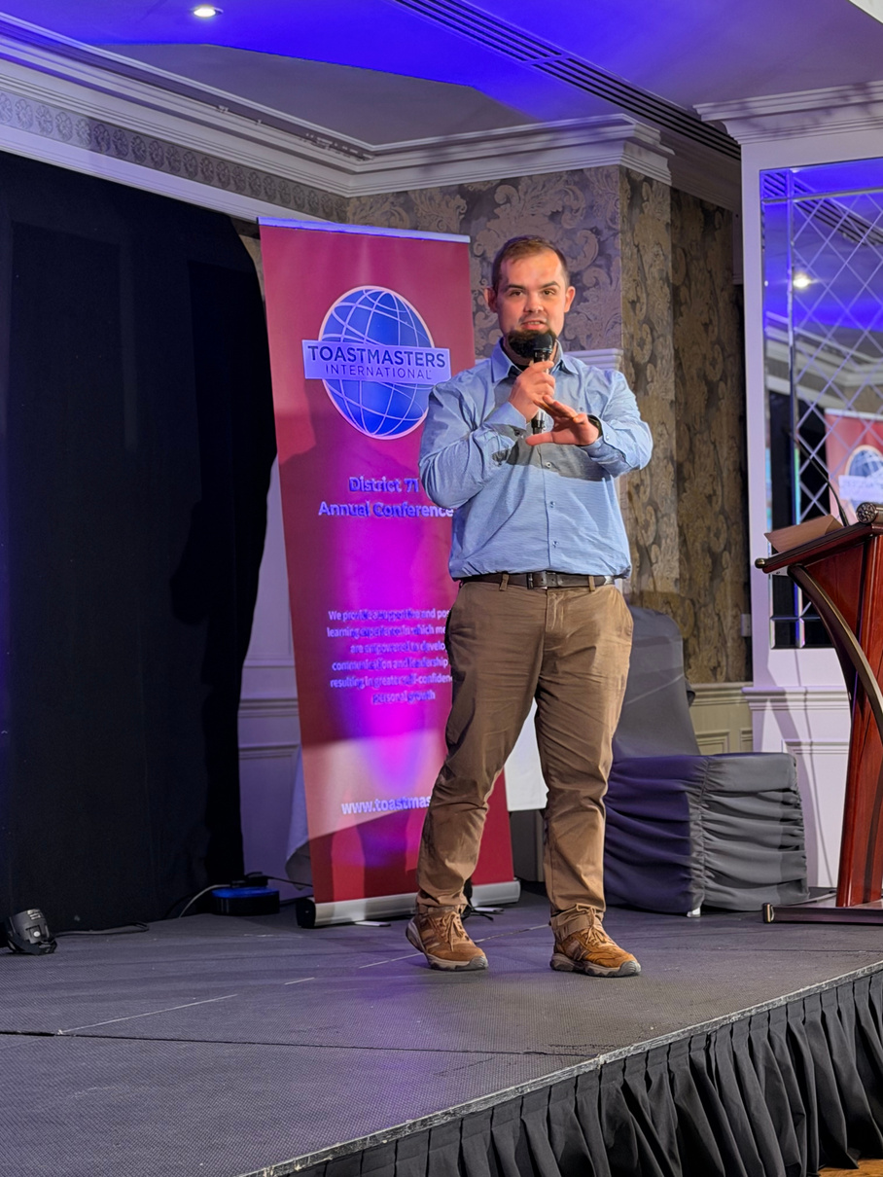
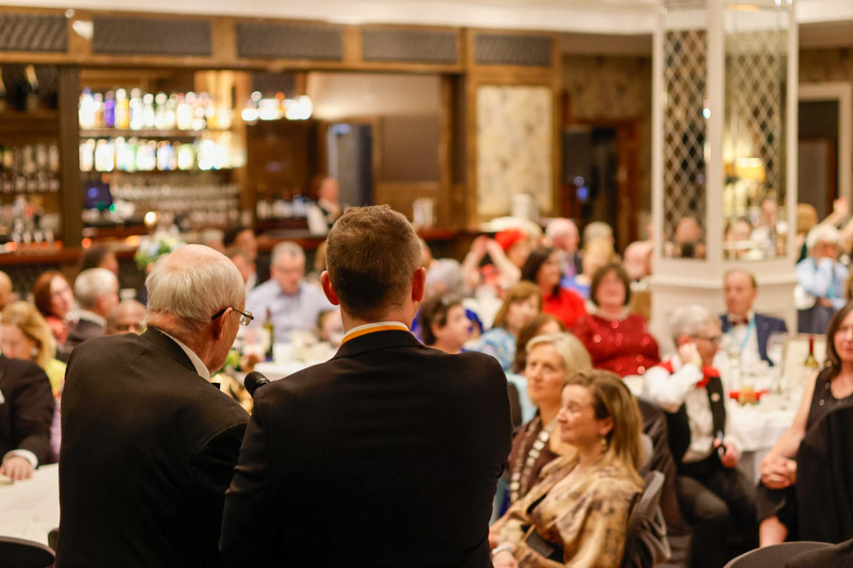
2027
Conference

Slide 41
SMILE!!

Slide 42
Digital Enablement Manager
Georgina Hodgkinson
AI-Enabled Leadership: Using AI Responsibly in Your District Role

Slide 44
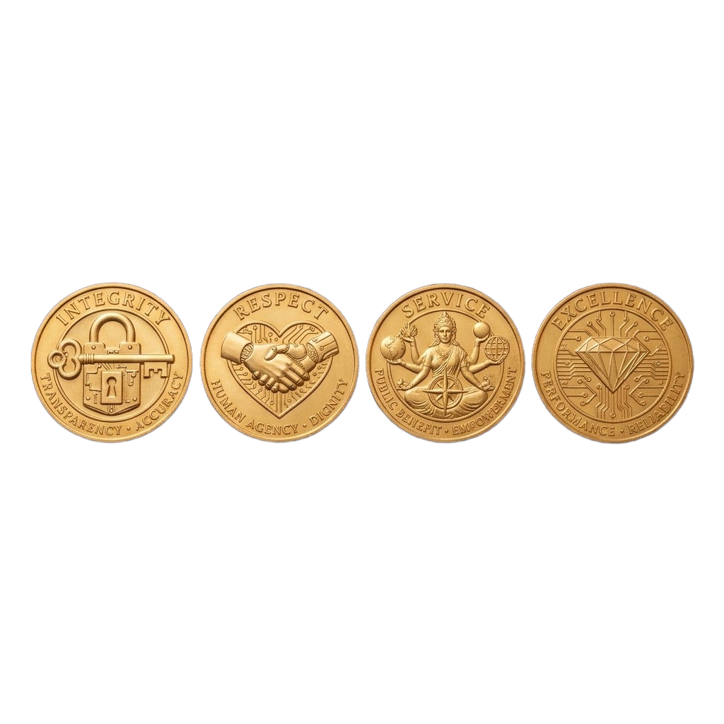

The 4 Golden Values of Responsible AI
INTEGRITY Be Transparent:
If you use AI it is best practice to let your team know it was AI-assisted. Transparency builds trust.
RESPECT Protect Member Privacy:
Never upload Personally Identifiable Information into public AI tools. Keep member names, phone numbers, email addresses, and specific club financial data out of your prompts.
SERVICE Maintain the Human Touch:
Leadership is built on relationships. While AI can draft an email, take the time to personalise it. Empathy, encouragement, and nuanced feedback must come from you, not an algorithm.
EXCELLENCE Verify Before You Send:
AI can "hallucinate" or provide outdated information. Always check AI generated facts, especially regarding Toastmasters International policies, Distinguished Club Program (DCP) rules, or contest regulations.

Slide 46
WISDOM OF THE ROOM
20 mins - Find Person in the Room Activity
Name & What tool

Slide 48
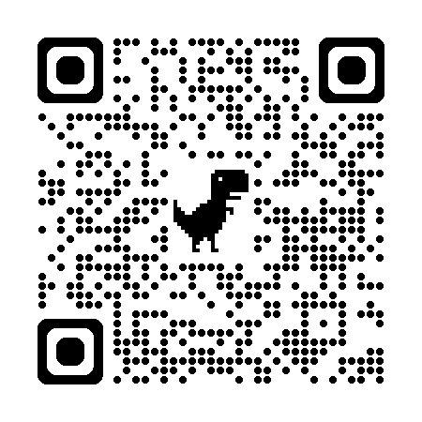
FEEDBACK
District Task | WHAT TOOL DID YOU USE | WHAT WOULD YOU RECOMMEND TO TRY
CREATE QUESTIONS FOR A Club Visits Report | CHAT GPT - FREE VERSION | You are an Area Director. Draft a template of questions to ask club officers during your club visits.
CREATE FORMULAE FOR Data & Reporting | Google Workspace AI | Ask AI to explain the math behind the DCP requirements for a specific club scenario.
CREATE POSTER IMAGES for Speech Contests | Claude - FREE VERSION | Brainstorm engaging themes, icebreakers, or promotional social media captions.
Role Play with AI for Mentorship / Coaching practice | Gemini - FREE VERSION | How do I start a difficult conversation with a club president who is feeling burned out?

Slide 50
“Your Toastmasters club is your laboratory in which to try experiments in better communication.”
Dr. Ralph C. Smedley

Slide 52
Program Quality Director
Kevin O’Reilly
Recognising the good, great and fantastic of a club and its members

Slide 53
Distinguished or better clubs
Lagan Valley Toastmasters | D
Engineers Club | D
Greystones Club | S
Talk Club @ Letterkenny | S
Belfast Toastmasters | M
Castleknock Toastmasters Club | P
Navan Club | P
Phoenix-Tara Toastmasters | M
Dublin 15 Toastmasters | M
Fil On Toast | D
Lucan Club | M
Clondalkin Talkin' | M
Rathfarnham Club | S
Tallaght Toastmasters | P
Tara Toastmasters | P
Dublin South TM | M
Sandyford TM | S
Tullamore Toastmasters Club | D
Athlone Club | S
Mullingar Toastmasters Club | M
Galway Club | M
Corrib Oranmore TMC | M
Naas Club | P
Portlaoise Club | D
Westport Speakers Club | D
Monaghan TM | S
Glasnevin Club | P
Ennis TMC | D
Dublin Club | D
Deloitte Toastmasters | D
IE Templebar TM | D
IFSC Toastmasters | P
Hellfire Club | M
East Coast Club | P
Swords Toastmasters | M
Malahide Club | P
Fingal Toastmasters | M
Balbriggan TM | D
Limerick Toastmasters | D
Thurles TMC | S
Clonmel Toastmasters | P
Waterford DLS TMC | D
Galway Club | M
Corrib Oranmore TMC | M
Westport Speakers C. | D
Drogheda TM Club | S
Toastmasters4Golf | S
Cloudera Ireland TM | D
Powdermills Club | S
Guardian Toastmasters | D
Bishopstown TM | M
Tullamore TMC | D
Athlone Club | S
Mullingar TMC | M
Speak Easy Club | P
Tralee Club | S
Killarney Club | P
The Limerick Lilts | D
Innovative Leaders TM | D
Talking Heads Club | S

Slide 55
District Leadership Team
District Leaders Roadmap and Area Success Planning Sprint

Slide 57
District Trio
Steve, Kevin, Dan
Recognition Rocks! Commitments, Appreciation and Close

Slide 59
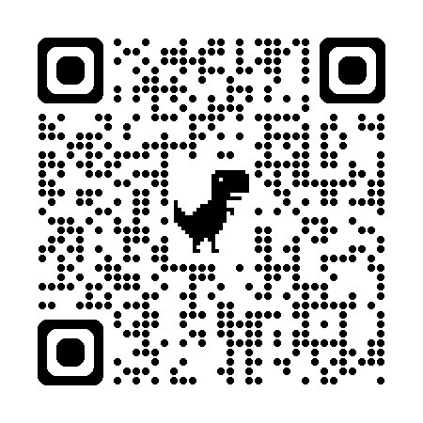
FEEDBACK

Slide 61
THANK YOU
SO MUCH!

